Slide 1
Surrogate Keys

Slide 2
A surrogate key to a Data Warehouse is what a primary key is for an OLTP source.
It is one of the basic elements of data warehouse design.

Slide 3
What is Surrogate Key?
A surrogate key is a system-generated (non-meaningful from a business perspective) primary key for purposes of ensuring uniqueness within a database table.
Data warehouses commonly use a surrogate key to uniquely identify an entity.
It is always INTEGER value.
Application data is not used to derive surrogate key

Slide 4
Associating SK with Database Auto Numbers
They can use:
Oracle sequence
SQL Server Identity
Access Auto Number
DB2 Identity
values for the surrogate key.

Slide 5
Relation with Dimension & Fact tables
The surrogate key is used as the primary key in the dimension table. The surrogate key will also be placed in the fact table and a foreign key will be defined in the fact table
When you ultimately join the data it will join just as any other join within the database.

Slide 6
Usage of Surrogate Keys
In Type 2 SCD

Slide 7
Type 2 SCD
The type 2 scenario requires the generation of a new unique key on the dimension as there will be multiple versions of the same source record each with the same source or business key. This new surrogate key is how the dimension is joined to the sales facts made for that version of the sales person.

Slide 8
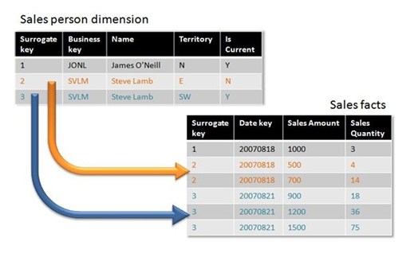

Slide 9
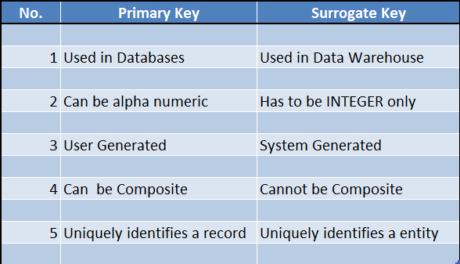
Primary Key Vs Surrogate Key

Slide 10
Primary Key Vs Surrogate Key

Slide 11
Primary Key Vs Surrogate Key

Slide 12
Primary Key Vs Surrogate Key

Slide 13
Primary Key Vs Surrogate Key

Slide 14
Primary Key Vs Surrogate Key

